Slide 1
Θεραπευτικές Εξελίξεις στην Καρδιακή Ανεπάρκεια 2021
Ευάγγελος Π. Ρεπάσος
Καρδιολόγος
Επιμελητής Α’
Θεραπευτική Κλινική ΕΚΠΑ
Θεραπευτικές Εξελίξεις 2022
16 Απριλίου 2022

Slide 2
Cardiac Myosin Activation with Omecamtiv Mecarbil in Systolic Heart Failure (GALACTIC HF)
8256 patients with symptomatic chronic heart failure EF<35%
omecamtiv mecarbil (25 mg, 37.5 mg, or 50 mg twice daily) or placebo, in addition to standard ΗF therapy.
The primary outcome was a composite of a first heart-failure event or death from cardiovascular causes
median of 21.8 months
Teerlink JR et al. NEJM 2021
Notes:
Ιδιες αρρυθμιες ιδια ισχαιμια

Slide 3
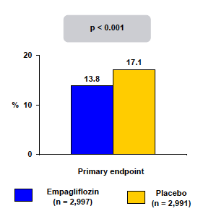
Empagliflozin in Heart Failure with a Preserved Ejection Fraction
Purpose:
Evaluate the effects of SGLT2 inhibitor (Empagliflozin) on cardiovascular death and heart failure hospitalizations in patients with heart failure with a preserved ejection fraction (HFpEF), with or without diabetes.
Trial Design: N=5998, International multicenter (randomized placebo controlled, double-blind, event-driven study. Symptomatic HFpEFpatients (LVEF>40%) received empagliflozin (10mg once daily) or placebo, in addition to usual therapy. Median follow up period was 26 months.
Primary Endpoint: Composite of CV death or heart failure hospitalization.
Anker S et al. NEJM 2021

Slide 4
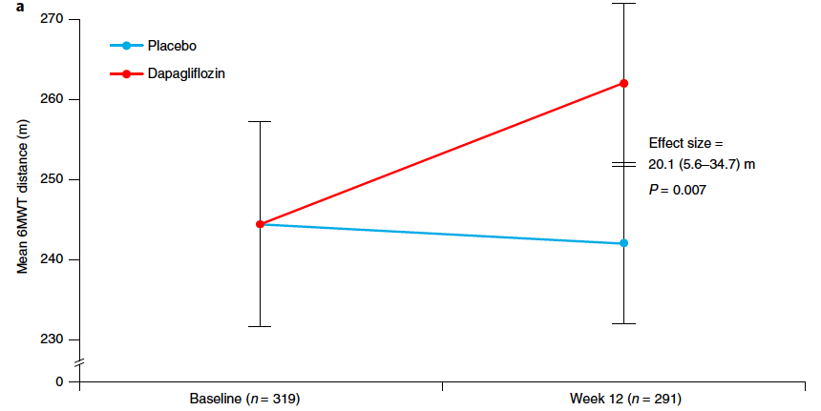
The SGLT2 inhibitor dapagliflozin in heart failure with preserved ejection fraction: a multicenter randomized trial (PRESERVED-HF trial)
324 pt randomized dapagliflozin vs placebo
EF 60%
FU 12 weeks
Nassif ME et al. Nat Med 2021

Slide 5
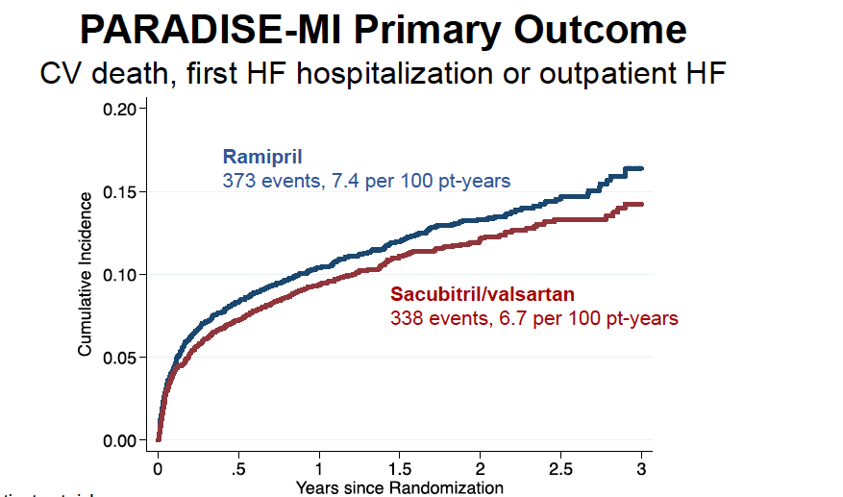
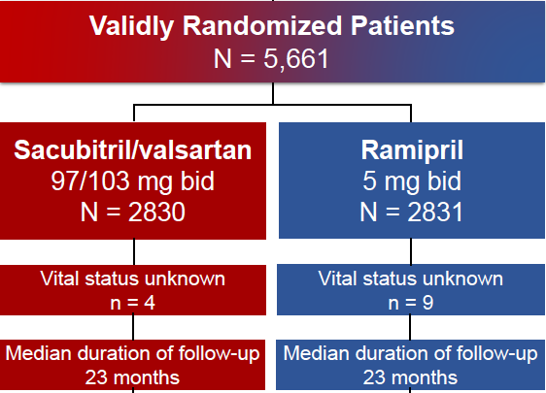
Angiotensin Receptor–Neprilysin Inhibition in Acute Myocardial Infarction
Pfefer M et al. NEJM 2021

Slide 6
Pfefer M. ACC 2021

Slide 7
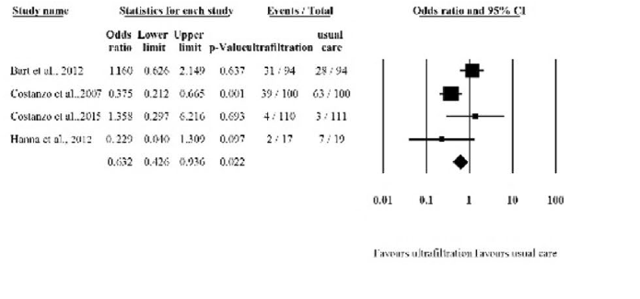
Ultrafiltration is better than diuretic therapy for volume‑overloaded acute heart failure patients: a meta‑analysis
8 RCT UF vs standard care 801 HF pt
UF increases fluid removal and weight loss and reduces rehospitalization and the risk of worsening heart failure in congestive patients, suggesting ultrafiltration as a safe and effective treatment option for volume-overloaded heart failure patients.
Wobble B et al. Heart Fail Rev 2021

Slide 8
Strain-Guided Management of Potentially Cardiotoxic Cancer Therapy
GLS-guided CPT prevents reduction in LVEF and development of CTRCD in high-risk patients undergoing potentially cardiotoxic chemotherapy, compared with usual care
In patients at risk of CTRCD, initiation of cardioprotective therapy (CPT) is constrained by the low sensitivity of ejection fraction (EF) for minor changes in left ventricular (LV) function. Global longitudinal strain (GLS) is a robust and sensitive marker of LV dysfunction, but existing observational data have been insufficient to support a routine GLS-guided strategy for CPT
Thavendiranathan et al. JACC 2021

Slide 9
Improved Risk Stratification for Ventricular Arrhythmias and Sudden Death in Patients With Nonischemic Dilated Cardiomyopathy
Αναδρομική μελέτη καταγραφής 1165 ασθενών με διατατική μυοκαρδιοπάθεια που υποβλήθηκαν σε CMR και διάμεσο χρόνο παρακολούθησης 36 μήνες

Slide 10
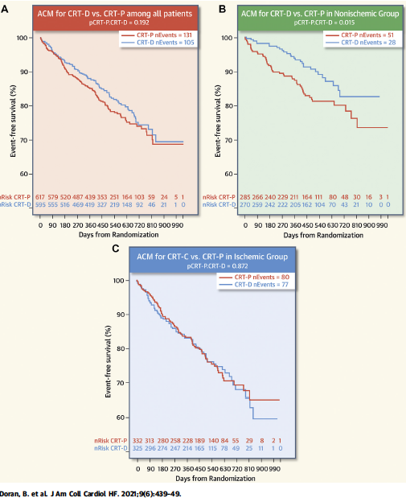
The Addition of a Defibrillator to Resynchronization Therapy Decreases Mortality in Patients With Nonischemic Cardiomyopathy
Doran et al. JACC HF 2021

Slide 11
AV junction ablation and cardiac resynchronization for patients with permanent atrial fibrillation and narrow QRS: the APAF-CRT mortality trial
60 % EF>35%
Brignole M et al. Eur Heart J 2021

Slide 12
AV junction ablation and cardiac resynchronization for patients with permanent atrial fibrillation and narrowQRS: the APAF-CRT mortality trial
Brignole M et al. Eur Heart J 2021

Slide 13
A Randomized Trial of His Pacing Versus Biventricular Pacing in Symptomatic HF Patients With Left Bundle Branch Block (His-Alternative)

Slide 14
A Randomized Trial of His Pacing Versus Biventricular Pacing in Symptomatic HF Patients With Left Bundle Branch Block (His-Alternative)
Vinther M et al. JACC 2021

Slide 15
Ευχαριστώ για την προσοχή

