Slide 1
Δυσλιπιδαιμίες
ΘΕΡΑΠΕΥΤΙΚΕΣ ΕΞΕΛΙΞΕΙΣ
2022
Κίμων Σταματελόπουλος

Slide 2
Νεότερα δεδομένα στην αντιμετώπιση της υπερχοληστεριναιμίας

Slide 3
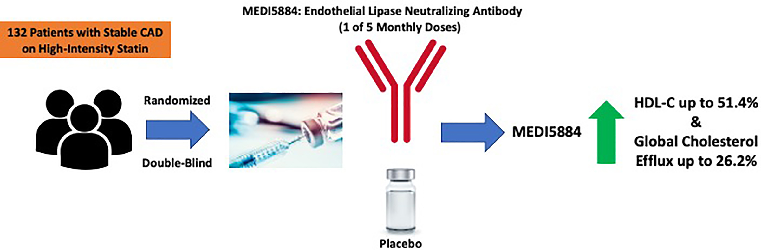
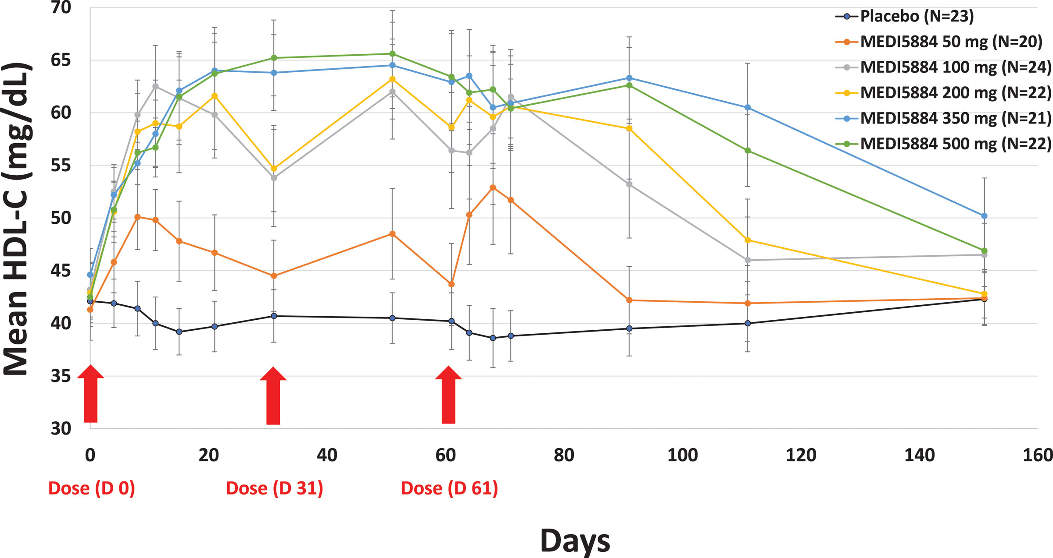
Inhibition of Endothelial Lipase by MEDI5884
increases the quantity and improves quality of functional HDL
Monoclonal antibody
target: endothelial lipase (EL)
Ruff et al. Arterioscler Thromb Vasc 2021
Notes:
EL (endothelial lipase) hydrolyzes phospholipids promoting catabolism of HDL and subsequent renal excretion.

Slide 4
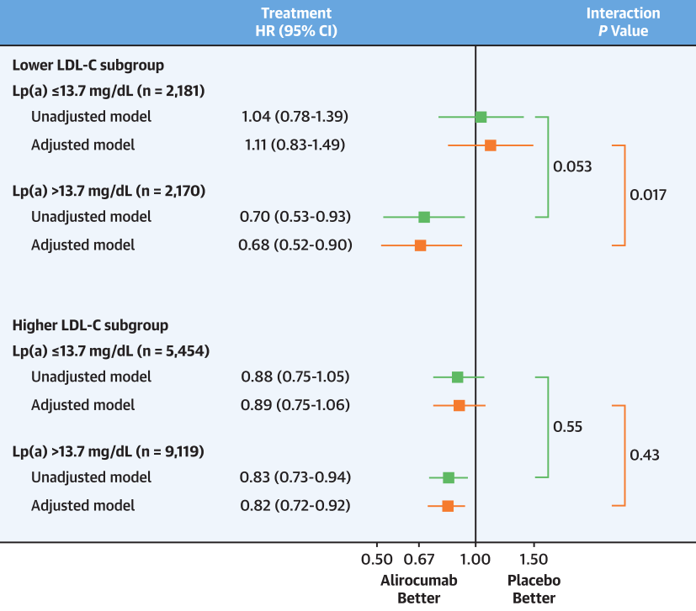
At LDL<70 mg/dl, alirocumab reduces MACE on top of statins
only in patients with at least mildly elevated Lp(a)
Monoclonal antibody
target: PCSK9
Patients with recent ACS on optimized statin therapy and LDL-C <70 mg/dl
Schwartz et al. J Am Coll Cardiol 2021

Slide 5
No additional beneficial effect of Alirocumab achieved at LDL-C <25mg/dl
compared to to LDL-C 25-50 mg/dl
Monoclonal antibody
target: PCSK9
Patients with recent ACS
ALI = Alirocumab
PBO = Placebo
Schwartz et al. Circulation 2021

Slide 6
Anacetrapib confers extended reduction in major coronary events in patients with established ASCVD
Cholesteryl ester transfer protein (CETP) inhibitor
26,129 patients of REVEAL study after cessation of randomly allocated treatment
+20% RR reduction
treatment
No treatment
Sammons et al. Eur Heart J 2021
Notes:
lipophilic and accumulates in adipose tissue during continued dosing, creating a reservoir that leads to its slow elimination from the peripheral circulation.3 As a consequence, residual lipid-modifying effects— albeit substantially reduced—are observed for some years after stopping prolonged treatment.4,5

Slide 7
Rosuvastatin reduce MACE for at least 3 years after cessation of treatment in patients at moderate CV risk
(HOPE)-3 study: 9,326 patients without established CVD, with at least one CVD factor
CVD factors for inclusion: elevated waist-to-hip ratio, current smoking,
impaired fasting glucose, impaired glucose tolerance or diabetes requiring only diet control, estimated GFR 45-60 mL/min/1.73 m2 and family history of premature heart disease in first degree relatives.
treatment
No treatment
+17- 20% RR reduction
Bosch et al. Eur Heart J 2021

Slide 8
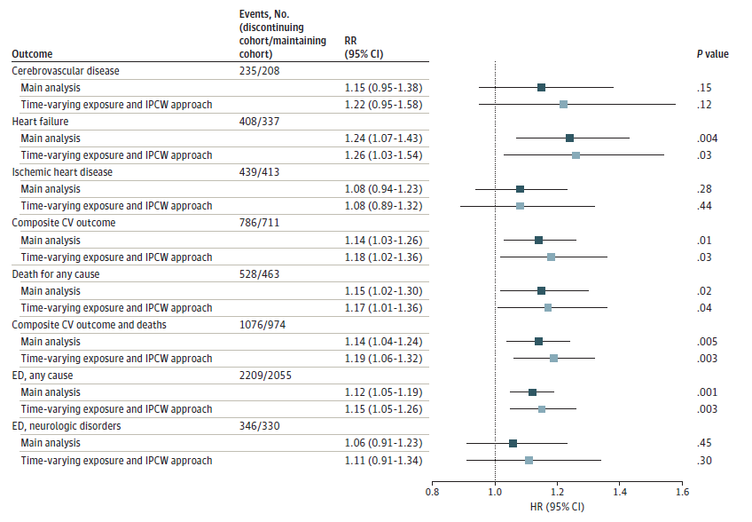
Discontinuation of statins increases CV outcomes
in elderly patients with polypharmacy
29,047 patients >65 years who were receiving uninterrupted treatment with statins, blood pressure–lowering, antidiabetic, and antiplatelet agents
ED: emergency department
Composite CV outcome: hospital admission for CV causes (cerebrovascular disease, heart failure, or ischemic heart disease)
5 years follow-up
Rea et al. JAMA Network Open 2021

Slide 9
Νεότερα δεδομένα στην αντιμετώπιση της υπερτριγλυκεριδαιμίας

Slide 10
N-3 PUFAs (EPA&DHA) do not reduce adverse events
in elderly patients with recent AMI
age range 70 to 82 years
1.8 g n-3 PUFA (930 mg eicosapentaenoic acid and 660 mg docosohexaenoic acid) daily
Primary outcome: a composite of nonfatal AMI, unscheduled revascularization, stroke, all-cause death, heart failure hospitalization after 2 years
Kalstad et al. Circulation 2021

Slide 11
EPA but not EPA & DHA stabilize coronary plaque characteristics
total plaque volume
EPA
EPA
+ DHA
Fan et al. Am J Cardiol 2021
Notes:
Data given as mean § SD or n. ACS = acute coronary syndrome; CAD = coronary artery disease; DHA = docosahexaenoic acid; EPA = eicosapentaenoic
acid; IPE = icosapent ethyl; NSTEMI = non-ST-segment elevation myocardial infarction; SAP = stable angina pectoris; UAP = unstable angina pectoris.

Slide 12
Παρενέργειες στατινών

Slide 13
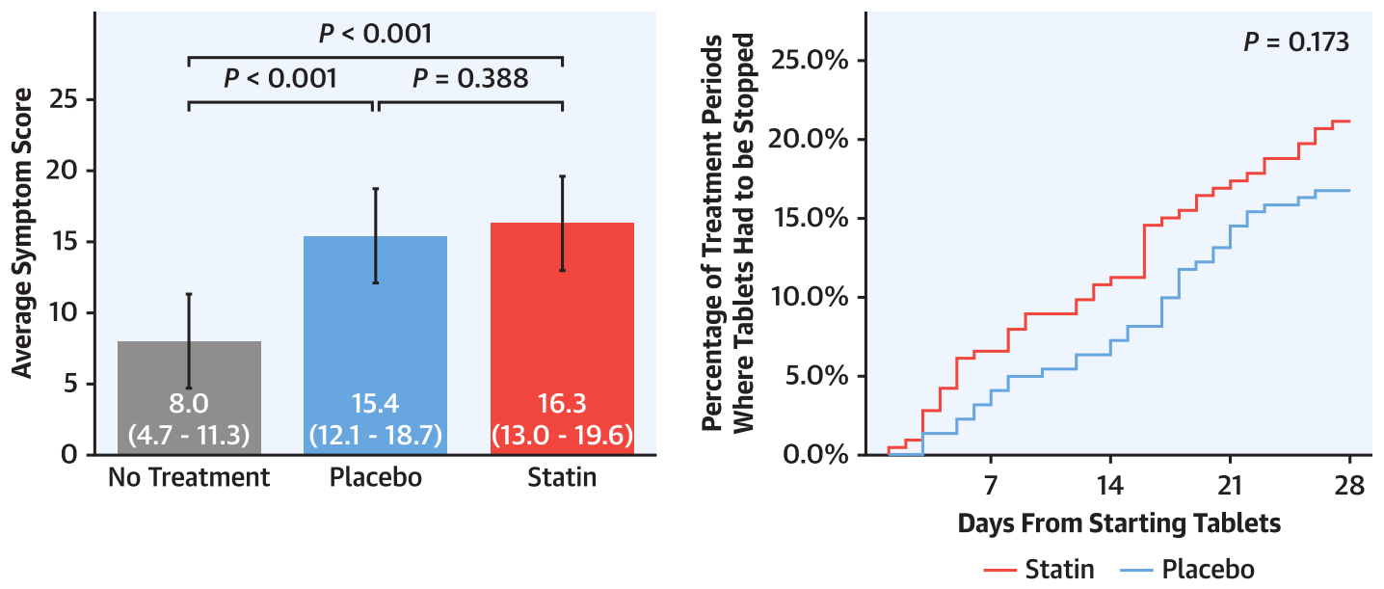
The majority of symptoms caused by statin tablets are nocebo
Identical adverse event pattern with placebo and statin
(muscle ache, fatigue or tiredness and cramps)
Howard et al. J Am Coll Cardiol 2021

Slide 14
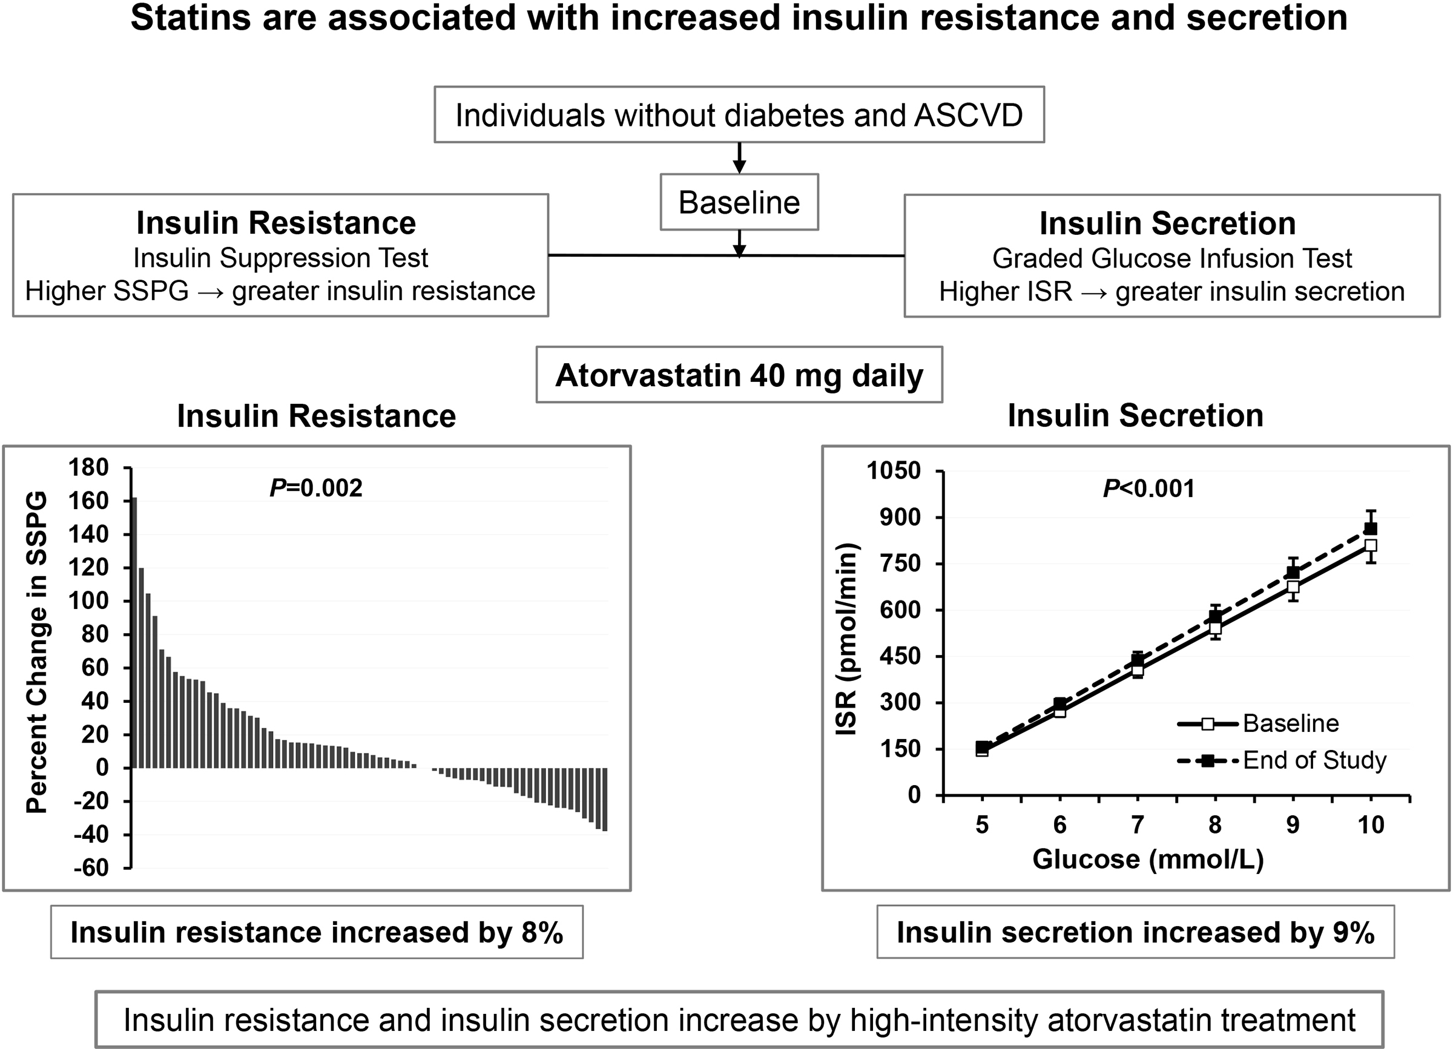
High-intensity atorvastatin increases insulin resistance and insulin secretion
open-label clinical trial
75 individuals enrolled
10 weeks follow-up
ISR = insulin secretion rate
SSPG = steady-state plasma glucose
Abbasi et al. Arterioscler Thromb Vasc 2021

Slide 15
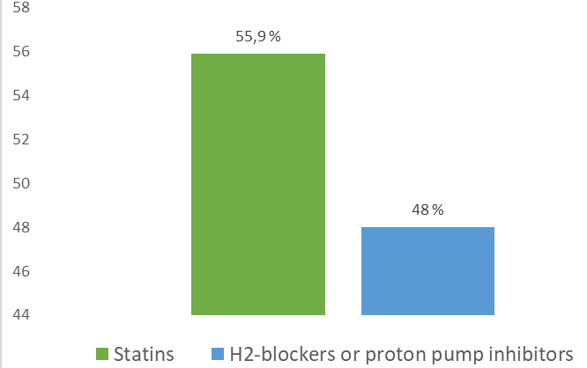
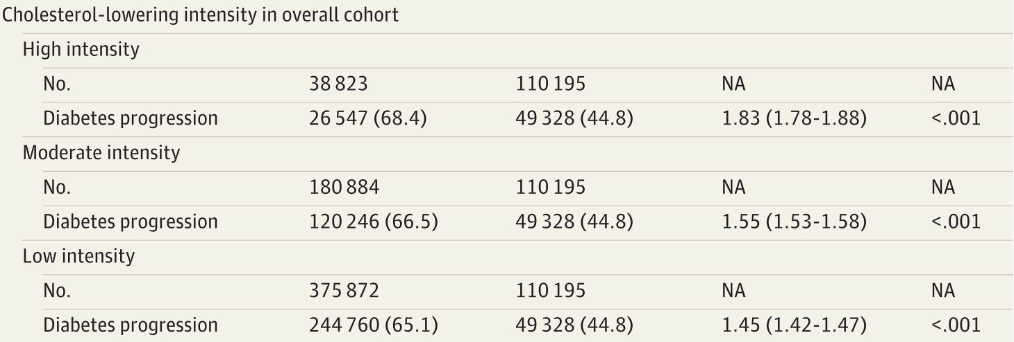
Statin use is associated with diabetes progression
Retrospective propensity-score matched cohort study
83 022 pairs from 705 774 patients with diabetes
OR 1.37 [1.35-1.40] P < .001
Dose-dependent increase
in risk for diabetes progression
HR
Diabetes progression outcome (%)
Diabetes progression outcome: new insulin initiation, increase in the number of glucose-lowering medication classes, incidence of 5 or more measurements of blood glucose of 200 mg/dL or greater, or a new diagnosis of ketoacidosis or uncontrolled diabetes
Mansi et al. JAMA Intern Med 2021

Slide 17
Icosapent ethyl (omega3 FAs) reduce the need for
first and subsequent coronary revascularizations (REDUCE-IT trial)
Statin-treated patients with elevated triglycerides and increased CV risk
4 g n-3 PUFA (high purity EPA) daily
Number of first and subsequent coronary revascularization events
Peterson et al. Circulation 2021

Slide 18
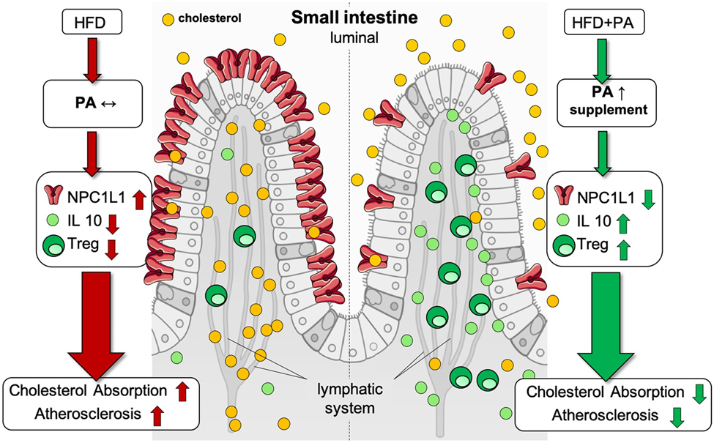
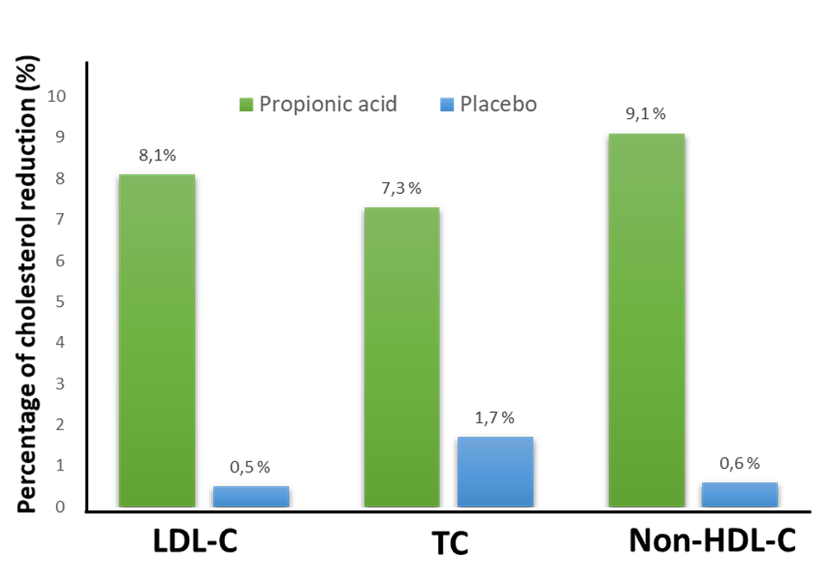
Propionic acid affect gut microbiome and reduces LDL-C through an immunological pathway
gut microbiota metabolite (fatty acid)
target: intestinal cholesterol transporter NPC1L1
500 mg of Propionic acid twice daily in subjects with elevated baseline LDL cholesterol levels.
HFD, high-fat diet; IL-10, interleukin-10; NPC1L1, Niemann-Pick C1-like 1; PA, propionic acid; Treg, regulatory T cell
Haghikia et al. Eur Heart J 2021

Slide 19
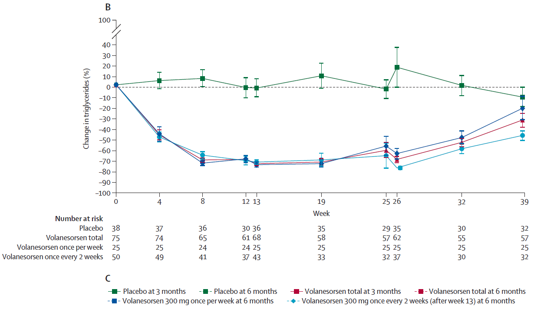
Volanesorsen decrease triglyceride levels in patients
with multifactorial or familial chylomicronaemia
anti-sense RNA
target: hepatic apolipoprotein C-III
-71%
Gouni-Berthold et al. The Lancet 2021

Slide 20
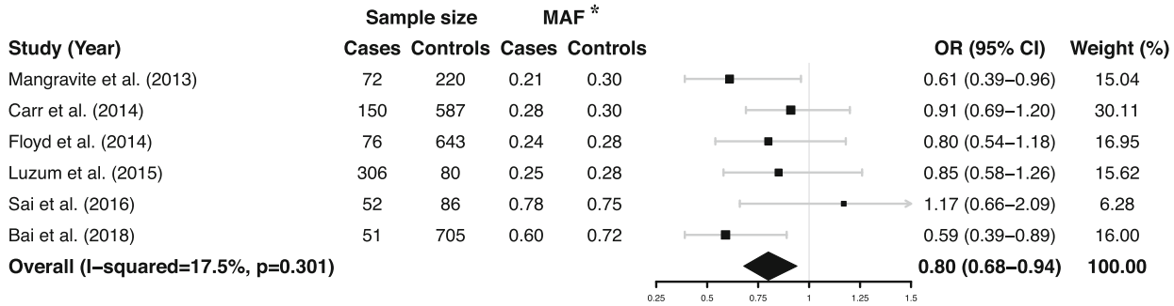
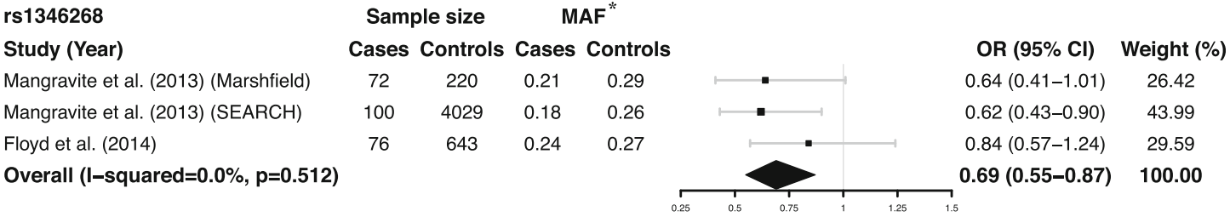
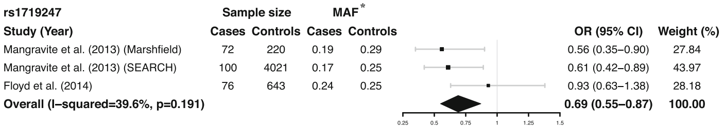
GATM polymorphism may be protective factor of statin induced myopathy
Statin induced myopathy
rs9806699 G>A
rs1346268 T>C
rs1719247 C>T
Polymorphism better
MAF= minor allele frequency
Liu et al. Eur J Clin Pharmacol 2021

Slide 21
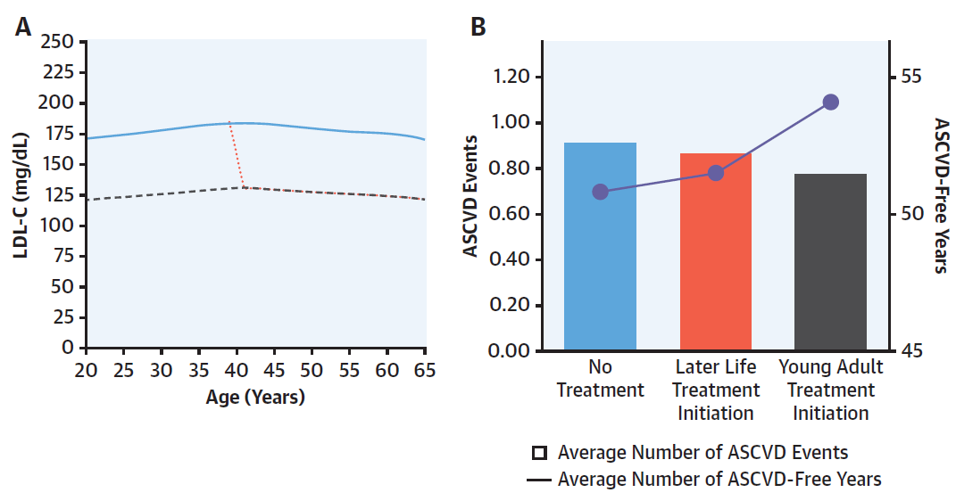
Statin treatment for LDL-C≥130mg/dl is cost effective for young adults
Highly cost effective for young men
Intermediately cost-effective for young women
Statin treatment was more cost effective than intensive lifestyle intervention
Kohli-Lynch et al. JACC 2021

Slide 22
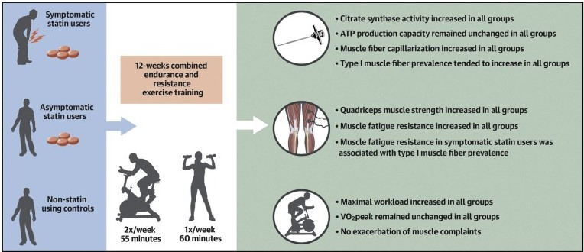
A moderate intensity exercise training program improves muscle performance without exacerbating muscle complaints in symptomatic statin users
Allard et al. J Am Coll Cardiol 2021

Slide 23
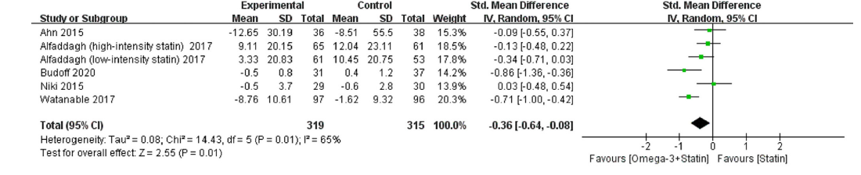
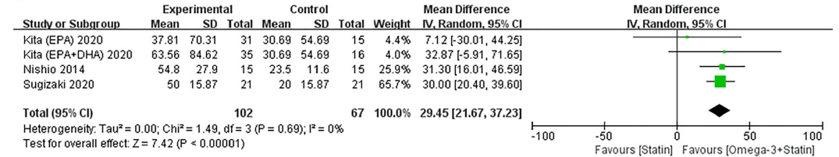
Omega-3 combined with statins stabilizes and promotes coronary plaque regression compared with statin alone
Total plaque volume change
Favours
[omega-3+statin]
Favours
[statin]
Fibrous cap thickness change
Favours
[omega-3+statin]
Favours
[statin]
Fan et al. Am J Cardiol 2021

Slide 24
EPA acts more beneficially on plaque progression
than EPA & DHA
Total plaque volume change
Favours
[omega-3+statin]
Favours
[statin]
Fibrous cap thickness change
Favours
[omega-3+statin]
Favours
[statin]
Fan et al. Am J Cardiol 2021

Slide 25
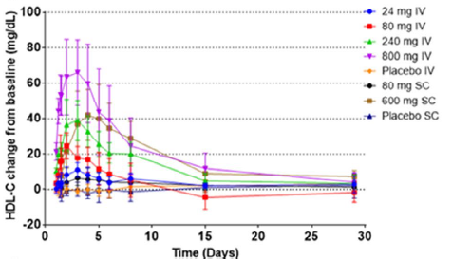
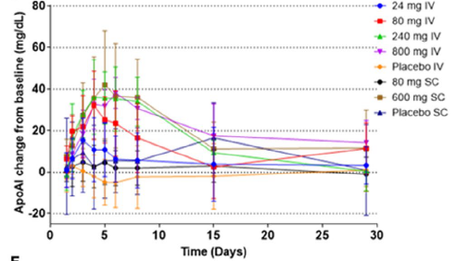
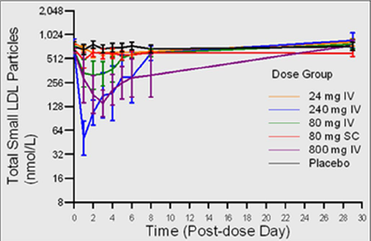
MEDI6012 is safe and improves the lipid profile of patients
48 subjects with stable coronary heart disease on a statin
HDL-C change
Recombinant human lecithin-cholesterol
acyltransferase
ApoA1 change
Small LDL particles
George et al. J Am Heart Assoc. 2021

Slide 26
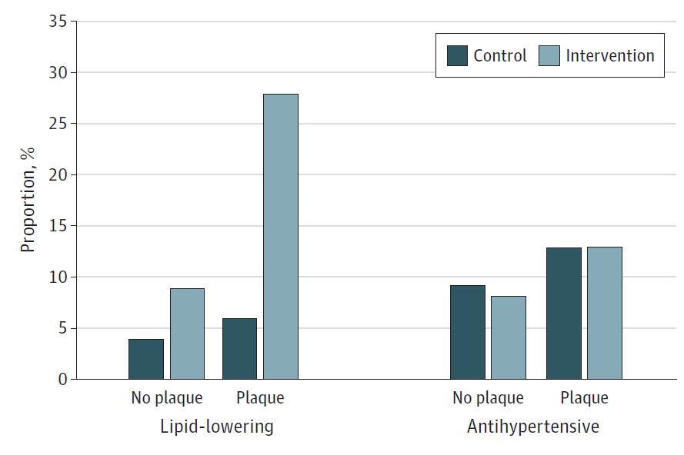
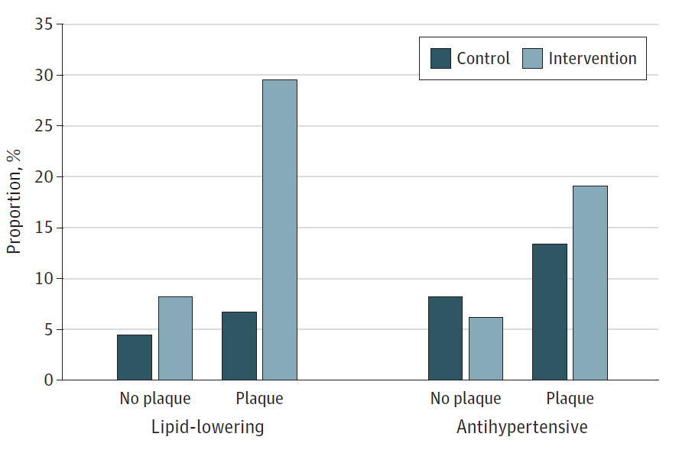
Information on carotid atherosclerosis can improve prescription of lipid-lowering drugs but not antihypertensive treatment
Women
Μen
RCT: including 3,532 participants low-moderate CVD risk
Carotid atherosclerosis: carotid
intima-media thickness and carotid
plaques
P<0.001 for both
Sjölander et al. JAMA Net Open 2021

Slide 27
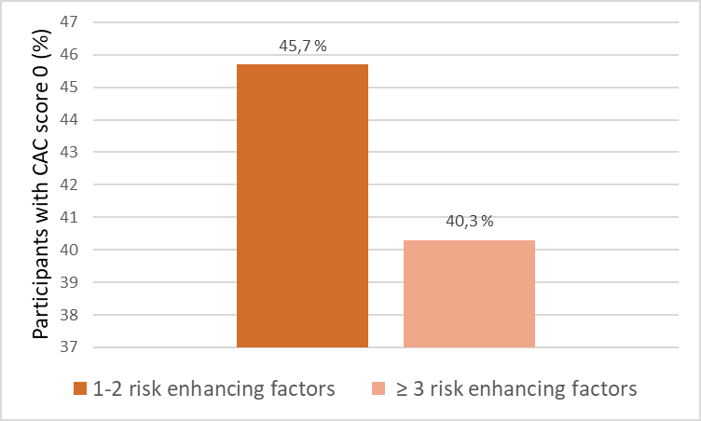
CAC score improves reclassification of intermediate CV risk individuals who might benefit from statin initiation
Multi-Ethnic Study of Atherosclerosis
Prospective cross-sectional study
1688 participants
no clinical ASCVD or diabetes
12 years
<7.5 events per 1000 person-years for all individual risk-enhancing factors and combinations of risk-enhancing factors
CAC score 0: 42,8%
CAC scoring classify more accurately than risk enhancing factors individuals with an intermediate risk of ASCVD who might benefit from statin therapy
Net Reclassification Improvement for CAC was 0.067
Risk enhancing factors: family history of premature ASCVD, premature menopause, metabolic syndrome, chronic kidney disease, lipid and inflammatory biomarkers, and low ABI
Patel et al. JAMA Cardiol 2021

